Slide 1
KyCPA
Student Membership
CPA… three letters, a million possibilities

Slide 2



About the KyCPA
A state-wide,
non-profit professional organization serving nearly 4,000 CPAs
Active in Frankfort
Membership consists of 50% public accounting & 50% business, industry, government, & education

Slide 3
KyCPA Student Member Benefits
Student membership is FREE!
Scholarship opportunities
FREE CPA Exam Workshops, College to Accounting Professional University (CAP U), Accounting Interview Day, & more
Discounts on CPA exam review courses
Eligibility to serve on committees
E-subscription to the Kentucky CPA Journal & monthly student e-newsletter
Invitation to member-only events
Free membership up to 1 year after graduation

Slide 4

The CPA Exam
CPA Exam Prep Workshops
  Overview of application process by Kentucky State Board of Accountancy
  Becker CPA mini-review
  Panel of newly licensed CPAs
    October 10 & November 21, 5:30-7:30pm EST
Mock CPA Exams
  A FREE mock CPA Exam section of your choice
  Proctored by Surgent CPA Review via Zoom
    October 17, 2:00-6:00pm EST
Register on the KyCPA website
Notes:
QR code for things that are website

Slide 5
Educational Foundation Scholarships
Annual scholarships for Kentucky accounting students
Amounts up to $2,500
Recognize academic achievement and leadership qualities in future KY CPAs
Must be a KyCPA student member
Applications accepted Nov 1 2024 – Feb 14 2025

Slide 6
Diversity & Inclusion Scholarship
CPA Review Materials for racial/ethnic minority students
Geared towards seniors or recently graduated students who are ready to take the CPA exam
Scholarship application opens Spring 2025

Slide 7
CAP U
Topics Include:
LinkedIn workshop
Career opportunities panel
CPA exam panel
Accounting Jeopardy
Interview tips
Mock interviews
Meet the Firms reception
Mold the Skills You Need to Stand Out at CAP U
Designed to enhance professional skills, develop leadership skills, master interviewing techniques, perfect networking and communication skills, & learn about career opportunities.
Next CAP U is Nov 8-9 2024 in Louisville

Slide 8
Student Ambassador Program
Purpose
Benefits
Build awareness of free KyCPA student membership benefits and programs
Increase visibility of KyCPA on your campus
Strengthen ties between KyCPA and your school
Mentor opportunity
Letter of recommendation
Invitation to KyCPA spring awards banquet
Resume builder
Applications for Fall 2025—Spring 2026 positions open May 2025

Slide 9
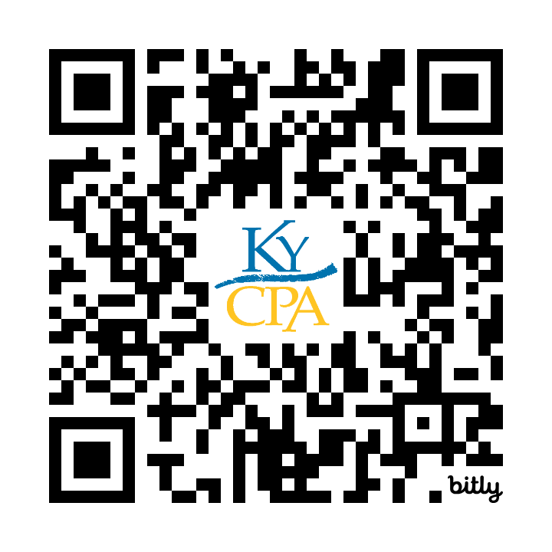
Employer Guide
What’s Inside?
Why CPA?
Why Join?
Get Involved
Become a CPA
CPA Exam
Licensure
Continuing Professional Education
Get Noticed, Get Hired
Firms

Slide 10

Useful Resources
Employer Guide
Future CPAs Page
Student Membership
Ambassador Application
Scholarships
CPA Exam
Jobs Board

Slide 11
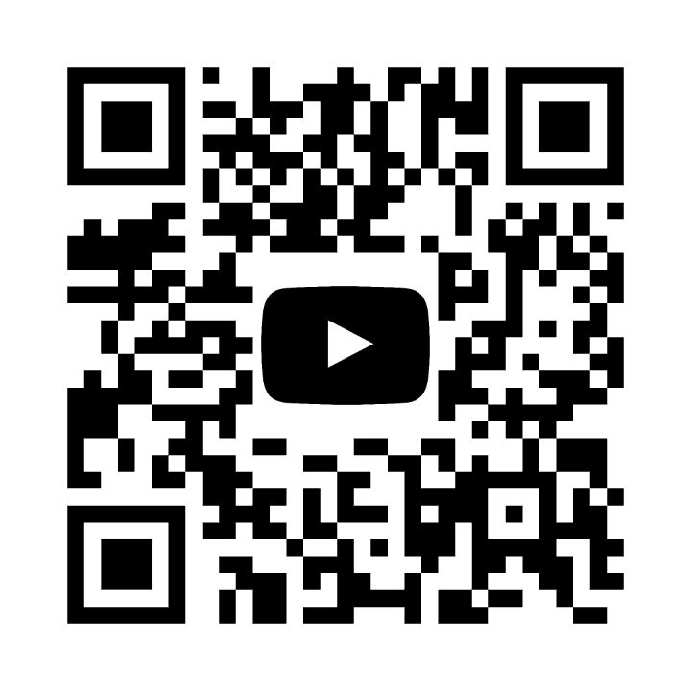




Get Connected!
YouTube
Twitter
Facebook
LinkedIn
Instagram

Slide 12
Join KyCPA for Free Today!
Network at local and statewide levels
Access member-only resources and scholarships
Stay connected wherever your education takes you

