Slide 1

Relationship of Leader-Member Exchange on Role Stress and Burnout: A Public Accounting Perspective
Dr. Sammie Parsley, CPA, CMA, CIA, CGMA
Tax Manager
Carr, Riggs, and Ingram, CPAs
sparsley@cricpa.com

Slide 2

The problem of burnout among CPAs
Service-oriented industry
Struggle for work-family balance
Compressed busy season
Firms struggle with voluntary turnover
Notes:
- Service oriented industry > accommodating client needs is pivotal to long-term success > driven by client demand
- meeting client demands often means accountants work long and strenuous hours
- Compressed busy season > tax season, audit season, unforgiving deadlines. Accountants often find themselves working well over 40 hours per week for weeks or months on end, especially during the first quarter of the calendar year.
- From an organizational perspective, the busy season acts as selection mechanism, a rite of passage, which identifies employees who work effectively under the most challenging circumstances.
- From a firm economic perspective, a high percentage of a firm’s billable hours are generated during this time, the busy season.

Slide 3

The Research Question
What is the effect of role stressors moderated by positive leader-member exchange (LMX) on job burnout of millennial certified public accountants?
Notes:
- I care deeply about our young people. I care deeply about the young ppl entering the accounting profession. In my current role, I want to welcome them into a positive and nurturing environment.
- this study will stimulate discussion for increased need/importance of leadership skills to accounting practice.
- the AICPA in its Core Competency Framework for entry into the Accounting Profession emphasizes the importance of leadership skills, including the ability to motivate others, lead teams, and facilitate development of consensus.
Millennial characteristics: technologically savy; embrace diversity; desire open communication; work in teams; work life balance; value flexibility; want to make immediate impact; building a career is not a primary motivator for many millennials; work is a less significant part of their personal identity that with older generations
Gen X characteristics: self-sufficient; tendancy to be quiet achievers; strong emphasis on work life balance; often appear skeptical; experienced being laid off, restructured, relocated more than any other generation, acquiring skill sets necessary to adaptability
Boomer characteristics: original workaholics; advise young workers to wait their turn; value paying your dues; had little notion of work life balance

Slide 4
Significance and Research Implications
Stress can lead to decreased performance and negative job outcomes
  Health problems (Friedman et al., 1958)
  Increased group health premiums
  Increased absenteeism and subsequent turnover
  Academic implications
Notes:
Stress can lead to decreased performance and negative job outcomes
- study published in 1958 > 40 male accountants were examined for 6 months in 1957. Complete records were kept of weight, exercise, diet, and work loads. Results indicate that severe occupational stress are associated with sudden and profound rise in cholesterol levels. Lower levels of cholesterol were observed during times of minimal stress. Friedman found that cholesterol levels of tax accountants rose during tax season, peaked around 4/15, then declined to a more normal range by June.
- stress can generate health problems for individuals, deterioration of mental health, increased group health premiums, increased absenteeism, and turnover
- Employee turnover is costly > results in increased training and onboarding costs; lost productivity; decreased audit quality; quality of services being provided
- Academic implications > seems to be a mismatch between the desire for leadership skills in the accounting profession and the amount of attention these skills get within the accounting curriculum and universities.
- the development of leadership skills is a journey that begins by helping students perceive themselves as future leaders > resources can be utilized to help students develop a leadership mindset that will empower them to embrace future opportunities to develop leadership abilities. These may arise in the form of additional training/CPE and corporate sponsored training programs.

Slide 5
Conceptual Model: Role Stressors, LMX, and Burnout
Notes:
- builds upon previous works examining relationship between role stressors using quantitative methods
- dives deeper than previous studies, to my knowledge, by examining the specific impacts of role stressors, LMX, and burnout on the public accounting profession, specifically millennial cpas
- Focus will be on millennial cpas (born between 1982 and 2004)

Slide 6
Role Stressors (Katz & Kahn, 1978)
Role ambiguity – lack of clarity employees experience as a result of unclear expectations set by management
Role conflict – results from simultaneous contradicting communications and expectations from work peers and superiors
Role overload – sense of being overwhelmed that employees feel when there are too many responsibilities and demands to meet given time and personal constraints
Notes:
- role stressors typically generate negative emotions and can have an adverse effect on employees’ psychological states
- can result from a multitude of factors within a firm: violations of command; lack of autonomy; lack of feedback
- decreased performance may result from accountants who experience extended periods of role overload
- POINT: a moderate amount of overload may actually induce a positive impact on employee performance by increasing motivation and efforts in order to meet demand > known as eustress. This can be beneficial to both the individual accountant the firm itself

Slide 7
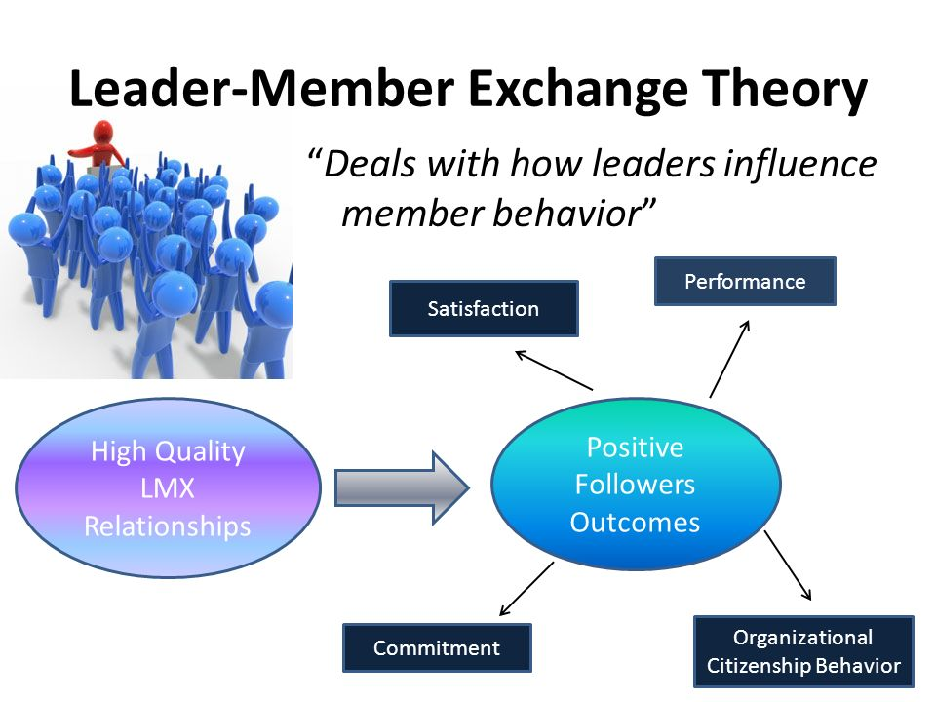
Leader-Member Exchange (LMX)
A relationship-based theory stating that relationships between leaders (e.g. managers, directors, partners, etc.) and members (e.g. subordinates) is one that develops over time as the result of numerous exchanges and transactions
Notes:
- LMX originally developed from an approach called Vertical Dyad Linkage Theory in the 1970s. During the 1980s, this was renamed Leader-Member Exchange.
- recent evidence has shown that a curvilinear relationship exists between LMX and stress. A high quality LMX relationship between a manager and a subordinate would be indicative of reduced stress for a subordinate, up to a correcting point. These managers provide increased communication, emotional support, and clearly defined roles, which reduce uncertainty and assists in keeping stress levels low
- subordinates in high quality LMX relationships experience several advantages: increased favor and rewards; increased communication from supervisors; decreased uncertainty. Subordinates in low quality relationships tend to experience the opposite.
- low quality relationship would lead to increased uncertainty and increased levels of stress

Slide 8

Job Burnout (Maslach & Leiter, 2008)
Emotional exhaustion
Depersonalization
Reduced personal accomplishment
Notes:
- burnout refers to negative psychological response to stressors and consists of 3 dimensions
- EMOTIONAL EXHAUSTION– represents the individual emotional strain of burnout. In regards to sequencing, often the first dimension experienced. It has also been identified in prior research as being the critical dimension of burnout. Of the three burnout components, emotional exhaustion scores have been found to be the best predictor of actual turnover. It is often regarded as the most salient proxy for burnout.
- DEPERSONALIZATION – negative or detached response to various job aspects; detachment and callousness toward clients and coworkers; provides an emotional wall between the accountant and job demands. A cynical attitude and poor performance are often symptoms of depersonalization.
- REDUCED PERSONAL ACCOMPLISHMENT – decreased self-efficacy, feelings of incompetence, and lack of workplace achievement
- each stressor may be manageable individually, but when occurring simultaneously with other stressors, may overwhelm the individual
-Poor job satisfaction, poor job performance, and high turnover intent are well established job outcomes associated with burnout.

Slide 9
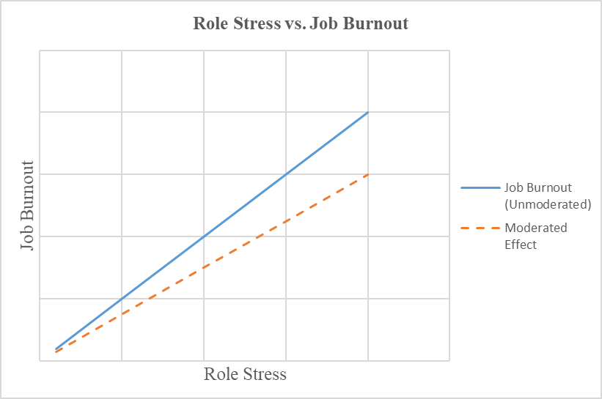
The Hypothetical Model
Hypothesis 1: Increased presence of role stressors will lead to increased existence of job burnout among millennial CPAs.
Hypothesis 2: Millennial accountants engaged in high quality LMX relationships with managers will experience lower levels of role stress and subsequent job burnout.
Notes:
- the unmoderated effect experiences increased levels of burnout as opposed to the effect moderated by positive LMX with managers and supervisors
In our next podcast, we are going to conclude as we will be discussing research findings, firm implications, and ways CPA firms can go about minimizing the adverse effects of role stress and job burnout.

